Slide 1
Spatial Commonsense Knowledge

Slide 2
Commonsense knowledge
Essential for many AI applications, including those in natural language processing, visual processing, and other tasks
For instance, in natural language understanding and visual understanding it allows to cope with incomplete, ambiguous and noisy information
Humans learn commonsense knowledge from life events and experiences
Can we acquire and store commonsense knowledge so that the machine can use it in (spatial) language understanding?
2

Slide 3
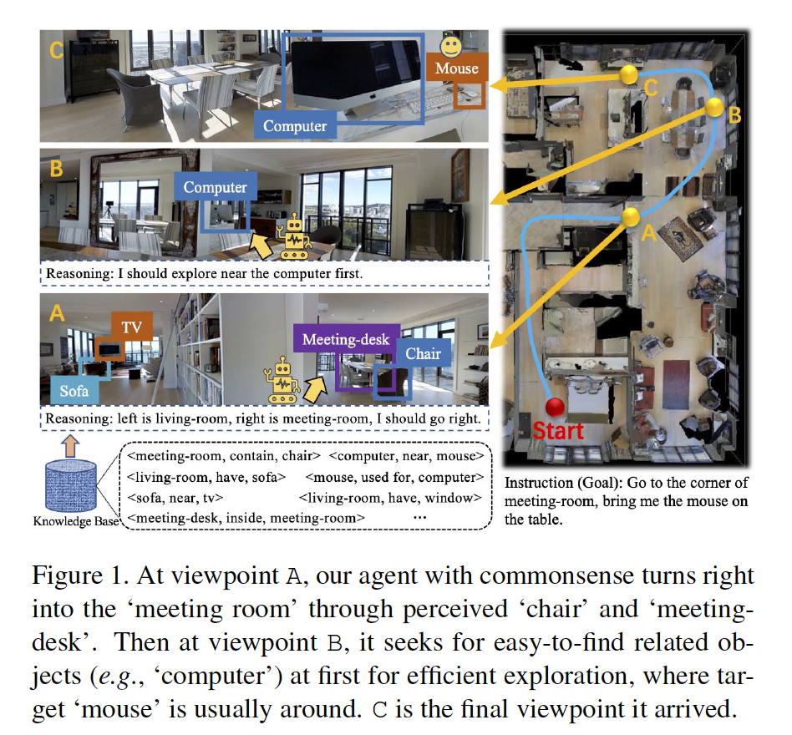
Spatial commonsense knowledge in knowledge bases
Stored in knowledge bases like ConceptNet
Here used in vision-language navigation task
Based on transformer architecture learns to generate scene memory tokens and utilize these informative clues for exploration
Chen Gao, Jinyu Chen Si Liu, Luting Wang, Qiong Zhang & Qi Wu (2021). Room-and-Object Aware Knowledge Reasoning for Remote Embodied Referring Expression. In Proceedings of IEEE Conference on Computer Vision and Pattern Recognition (pp. 3064-3073).
3

Slide 4
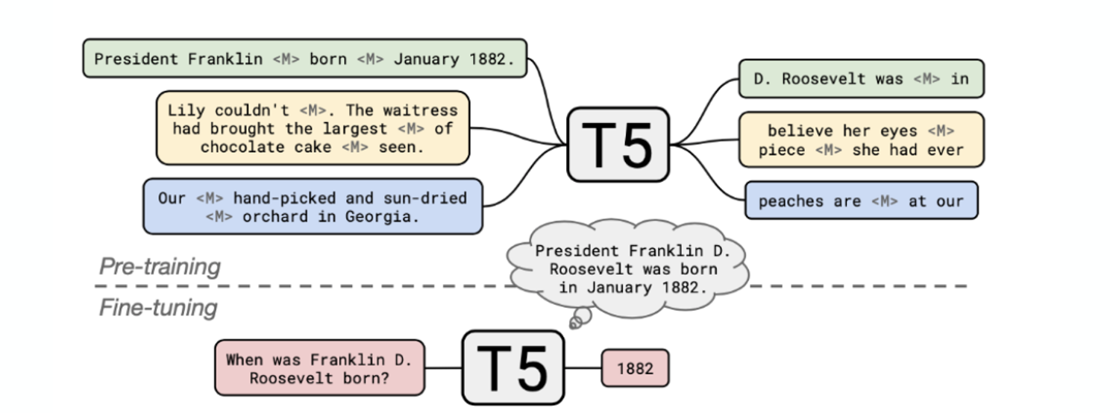
Learning from text: language models
Pre-trained language model (e.g., trained on Wikipedia texts) act as a knowledge storage
4

Slide 5
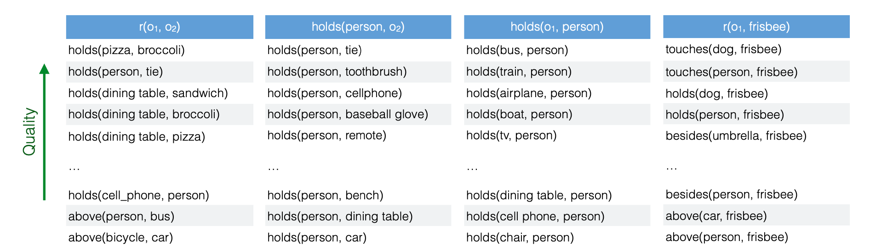
Learning from visual data
with pointwise mutual information statistic
Mark Yatskar, Vicente Ordonez, and Ali Farhadi (2016). Stating the Obvious: Extracting Visual Common Sense Knowledge. In Proceedings of the 2016 Conference of the North American Chapter of the Association for Computational Linguistics: Human Language Technologies (pp. 193–198). ACL.
5

Slide 6
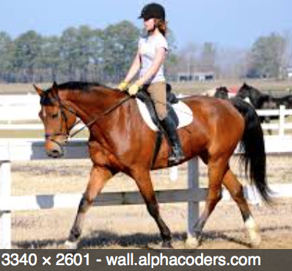
Learning spatial commonsense knowledge
From images paired with text
A girl rides a horse
We propose the task of:
Given a structured text input of the form (Subject, Relationship, Object) = (S,R,O)
Predict the 2D relative spatial arrangement of two objects (output)
Train the task in a supervised setting:
Training set of image-text pairs, where the size and location of bounding boxes of objects in images serve as ground truth
= a spatial “question-answering" task where the question consists in a spatial commonsense query such as where is the “man" located with respect to a “horse" when a “man" is “feeding" the “horse"?
The answer is a 2D “imagined” representation in contrast with a sentence/word as typically done in question-answering tasks
Collell, Guillem & Moens, Marie-Francine (2018). Learning Representations Specialized in Spatial Knowledge: Leveraging Language and Vision. Transactions of the Association for Computational Linguistics (TACL), 6, 133-144.
6

Slide 7
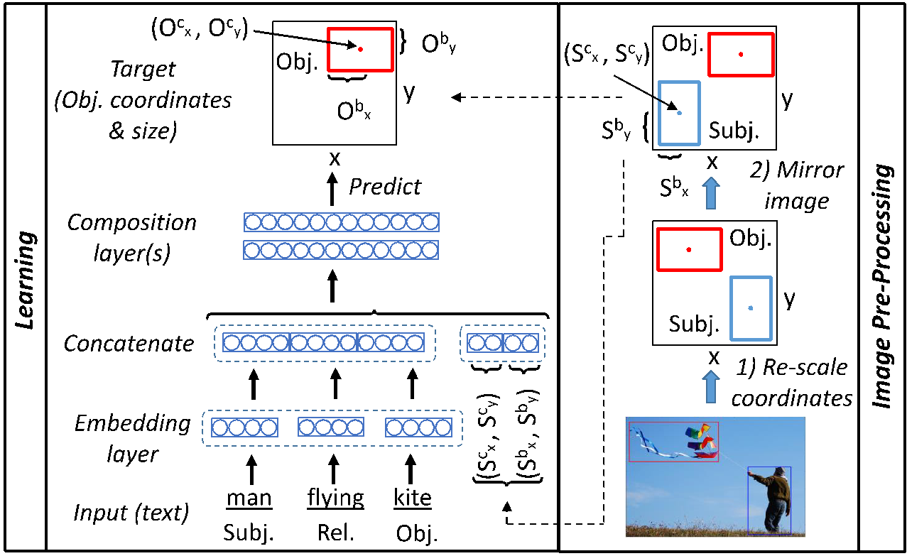
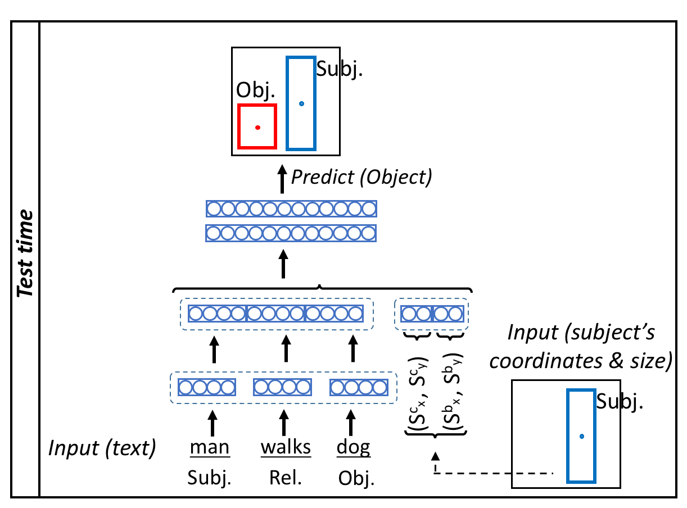
Simple feedforward neural network
Loss: mean squared error
Word embeddings to
generalize over unseen words
Triplet of words,
coordinates of subject
Guillem Collell, Luc Van Gool & Marie-Francine Moens (2018).
Acquiring common sense spatial knowledge through implicit spatial
templates. In Proceedings of the Thirty-Second AAAI Conference on
Artificial Intelligence (AAAI 2018) (pp. 6765-6772). AAAI.
7

Slide 8
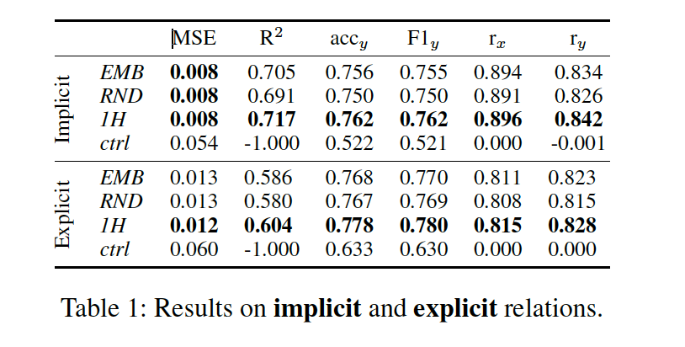
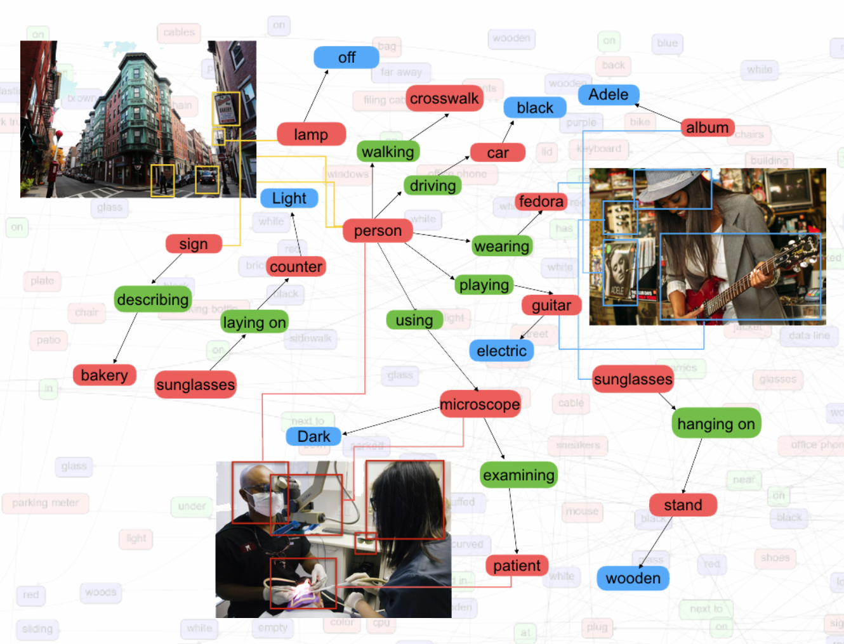
Learning spatial commonsense knowledge
Quantitative evaluation: 10-fold cross-validation and results averaged over the 10 folds
EMB: Glove embeddings as input
RND: Random embeddings as input
1H: 1-hot encodings as input
Ctrl: control method that outputs random normal predictions
Visual Genome data set: 108K images with 1,5M human-annotated (Subject, Relationship, Object) instances with bounding boxes for Subject and Object
8

Slide 9
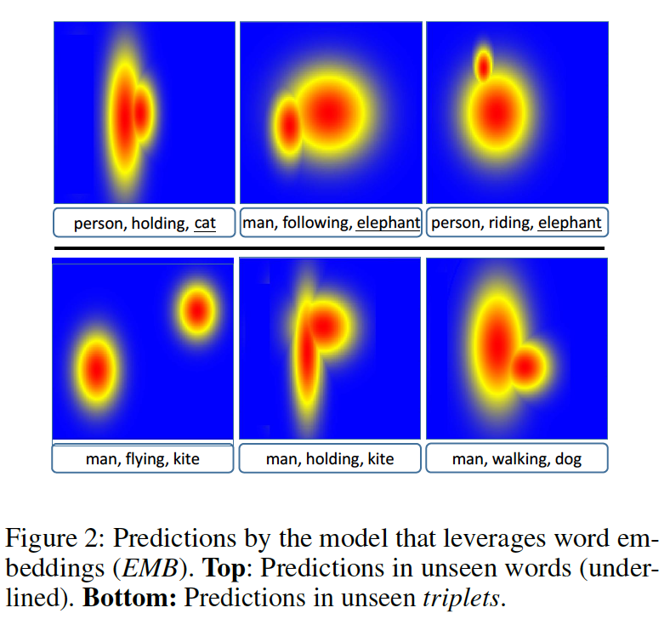
Learning spatial commonsense knowledge
Qualitative evaluation
Guillem Collell & Marie-Francine Moens (2017). Learning Visually Grounded Common Sense Spatial Knowledge for Implicit
Spatial Language. In Proceedings of the 13th International Symposium on Commonsense Reasoning, University College London. CEUR.
9

Slide 10
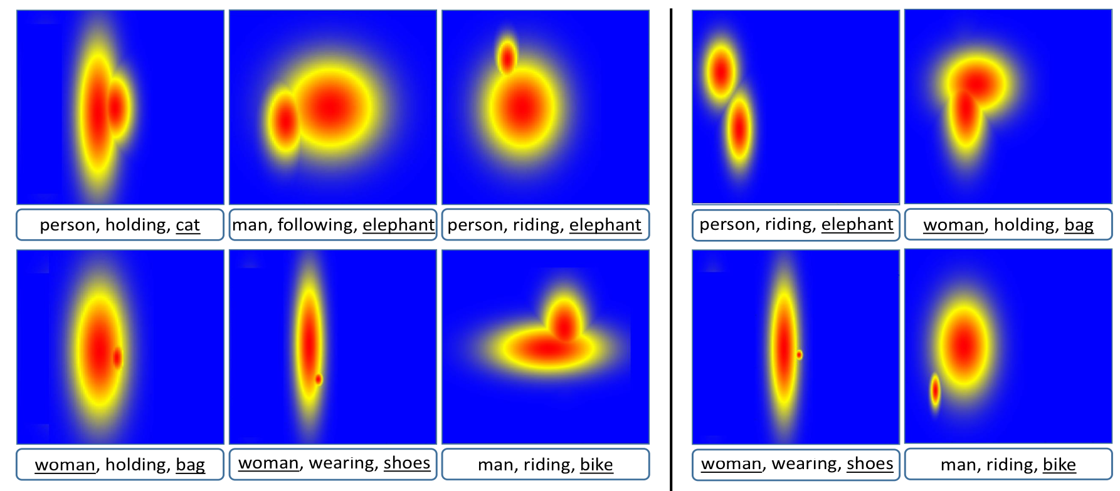
Learning spatial commonsense knowledge
Qualitative evaluation
Model: Initialized with distributed word embeddings
Model: Initialized with random word embeddings
10

Slide 11
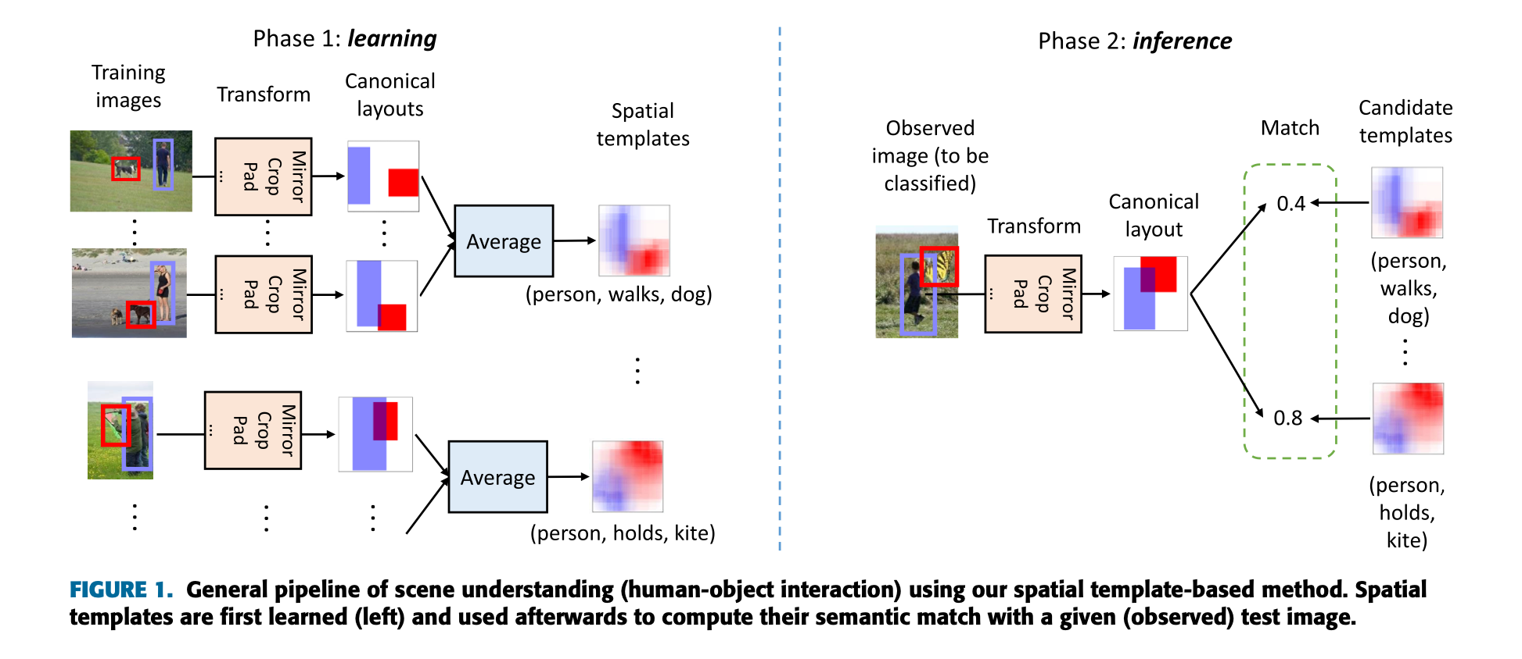
Learning spatial commonsense knowledge
Collell, Guillem, Deruyttere Thierry & Moens, Moens-Francine. (2021). Probing Spatial Cues: Canonical Spatial Templates for Object Relationship Understanding. IEEE Access 9, 134298-134318.
11

Slide 12
Learning spatial commonsense knowledge
Both visual (and other perceptual) and textual data are a source of commonsense knowledge
Learning spatial commonsense knowledge from large visio-linguistic models (e.g., CLIP)
Sources can be complementary
The knowledge can take different formats:
Symbolic language
Visual templates
Hidden nodes in neural network that could generate the above
12

Slide 13
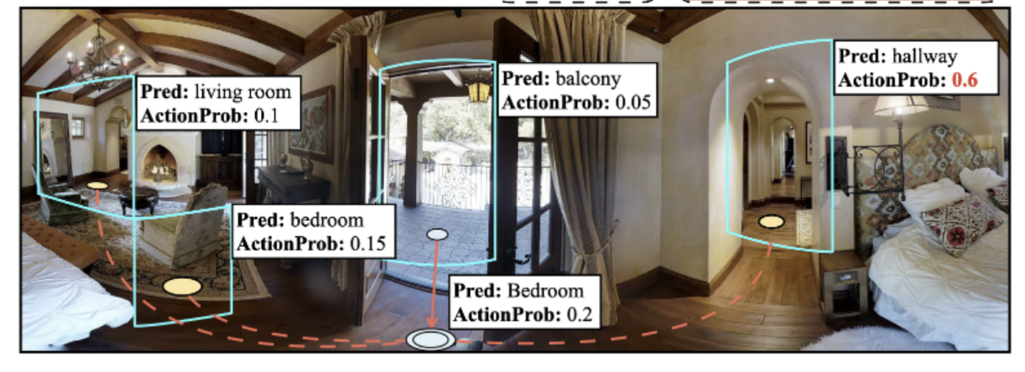
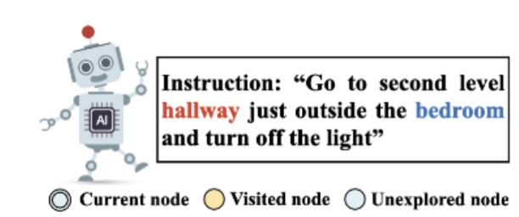
Using spatial commonsense knowledge in a vision-language navigation task
Task setup: Given a high-level instruction the agent needs to find the object described by the instruction
As the agent could be anywhere in the envrionment at the beginning, to correctly find the object, it needs to navigate to the position where the GT object becomes visible, then the agent can identiy the correct objects among all visible objects
Challenges: How to effectively explore the environment ?
How to better generalize to previously unseen environment ?
Mingxiao Li*, Zehao Wang*, Tinne Tuytelaars, Marie-Francine Moens. Layout-aware Dreamer for Embodied Referring Expression Grounding (under review).
13

Slide 14
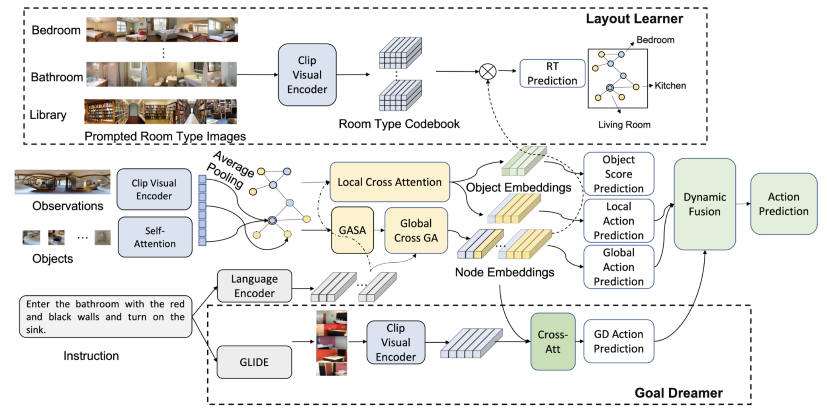
Using spatial commonsense knowledge in a vision-language navigation task
Learns to infer the room category distribution of neighboring unexplored areas along the path → effectively introduces layout common sense of room-to-room transitions
Baseline model: VLN-DUET [1]
Leverage the knowledge in pretrained text-image generation model → imagine the destination beforehand to help the agent to conduct more effective exploration
[1] Chen, S., Guhur, P.-L., Tapaswi, M., Schmid, C. & Laptev, I. 2022. Think Global, Act Local: Dual-scale Graph Transformer for Vision-and-Language Navigation. In Proceedings of the IEEE/CVF Conference on Computer Vision and Pattern Recognition, 16537–16547
Mingxiao Li*, Zehao Wang*, Tinne Tuytelaars, Marie-Francine Moens. Layout-aware Dreamer for Embodied Referring Expression Grounding (under review).
14

Slide 15

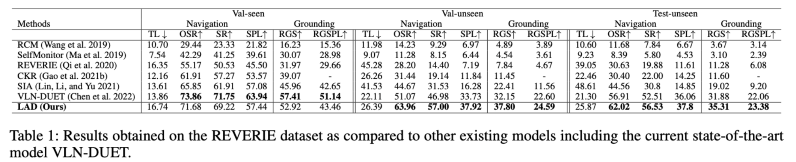
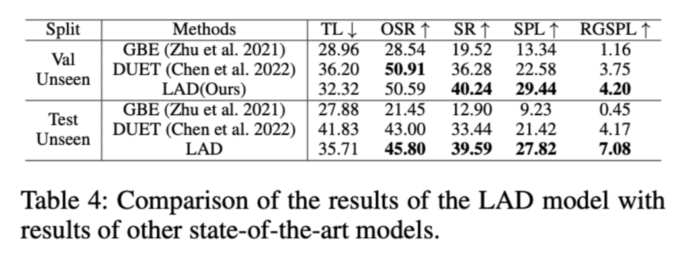
Using spatial commonsense knowledge in a vision-language navigation task
Results on REVERIE Dataset
Results on SOON Dataset
Mingxiao Li*, Zehao Wang*, Tinne Tuytelaars, Marie-Francine Moens. Layout-aware Dreamer for Embodied Referring Expression Grounding (under review).
15

Slide 16
Spatial Language Grounding and Text-to-Image Synthesis

Slide 17
It is well-known that humans "imagine" language content in a visual space
It is well-known that humans reason in spatial visual space
How to predict the spatial configurations and location of objects, actions, and their attributes in a 2D or 3D space?
= test of how well does the system understands spatial language
17

Slide 18
Language grounding in 2D or 3D physical space
This work has potential for real-time language understanding in a visual context:
Language communication to robots, machines, self-driving cars, …
Translation of spatial language to 2D or 3D space opens possibilities of quantitative reasoning in such a space, which can complement qualitative symbolic representations and reasoning
This work is a step towards opening the black box of neural models applied to language processing by visualizing the interpreted content
18

Slide 19
Text-to-image synthesis
Text-to-image or text-to-scene synthesis techniques aimed at naturally composing and visualizing text instances:
Many practical applications in education, gaming, creating virtual realities steered and manipulated through language
19

Slide 20
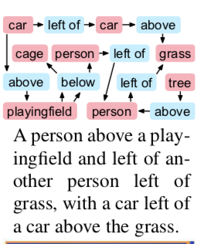
Text-to-image synthesis: integration of a scene graph
Text is first translated into a scene graph (= symbolic representation expressing the objects and their semantic/spatial relationships)
The spatial layout is generated from the scene graph
Use of a graph convolution network composed of several graph convolution layers to represent objects and their relationships
Followed by steps of layout prediction and pixel prediction
20

Slide 21
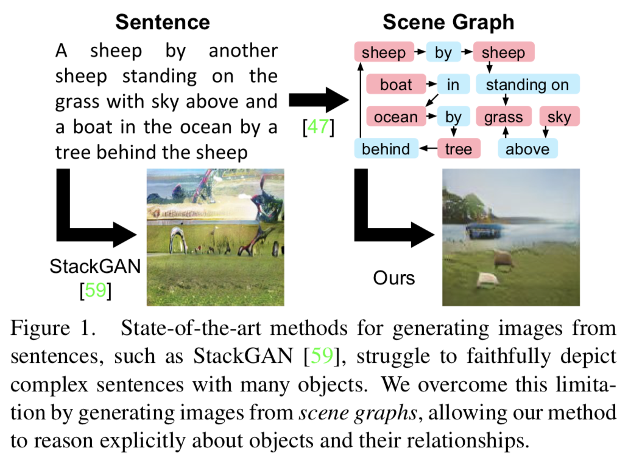
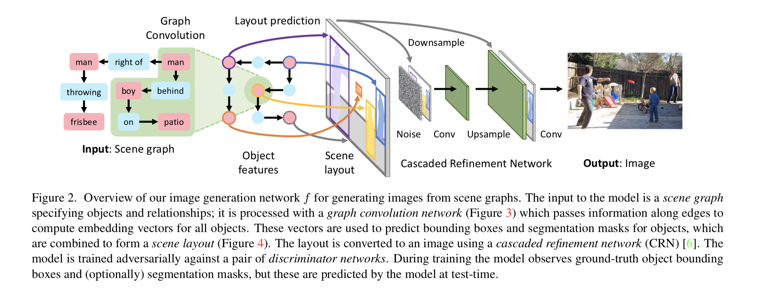
Text-to-image synthesis: integration of a scene graph
Justin Johnson, Agrim Gupta & Li Fei-Fei (2018). Image generation from scene graphs. In Proceedings of the Conference on Computer Vision and Pattern Recognition (CVPR).
21

Slide 22
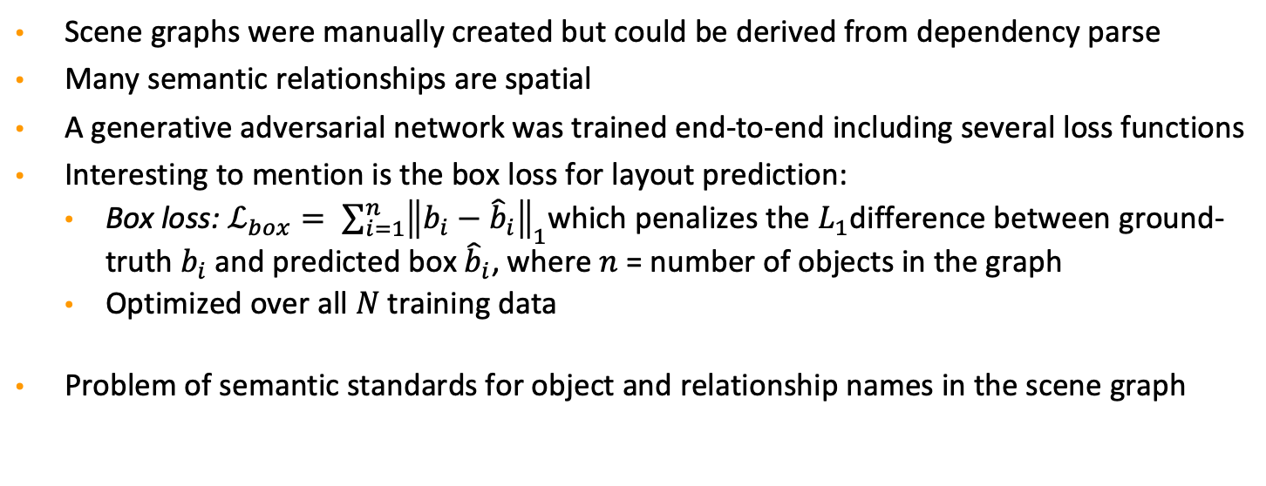
More details
Text-to-image synthesis: integration of a scene graph
Scene graphs were manually created but could be derived from dependency parse
Many semantic relationships are spatial
A generative adversarial network was trained end-to-end including several loss functions
Interesting to mention is the box loss for layout prediction:
Box loss: $ℒ_{box}= \sum_{i=1}^{n}{{\left\|b_{i}−{\hat{b}}_{i}\right\|}_{1}}$which penalizes the $L_{1}$difference between ground-truth $b_{i}$and predicted box ${\hat{b}}_{i}$, where $n$ = number of objects in the graph
Optimized over all $N$ training data
Problem of semantic standards for object and relationship names in the scene graph
Justin Johnson, Agrim Gupta & Li Fei-Fei (2018). Image generation from scene graphs. In Proceedings of the Conference on Computer Vision and Pattern Recognition (CVPR).
22

Slide 23
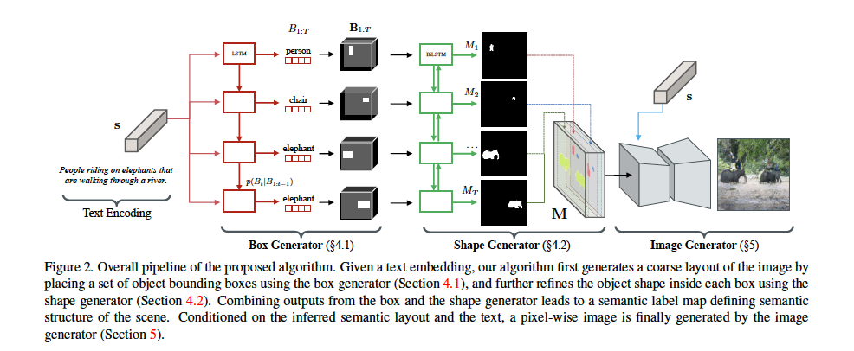
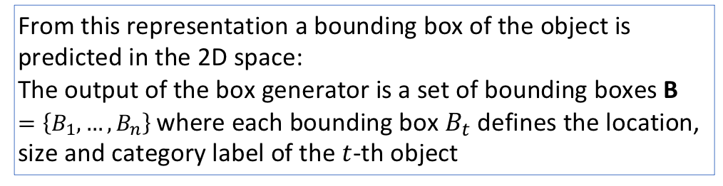
Text-to-image synthesis
From this representation a bounding box of the object is predicted in the 2D space:
The output of the box generator is a set of bounding boxes B $=\left\{B_{1}, …,B_{n}\right\}$where each bounding box $B_{t}$defines the location, size and category label of the $t$-th object
The LSTM encoder provides a representation (embedding) of each object mentioned in the input text
Seunghoon Hong, Dingdong Yang & Jongwook Choi (2018). Inferring semantic layout for hierarchical text-to-image synthesis. In Proceedings of the Conference on Computer Vision and Pattern Recognition (CVPR).

Slide 24
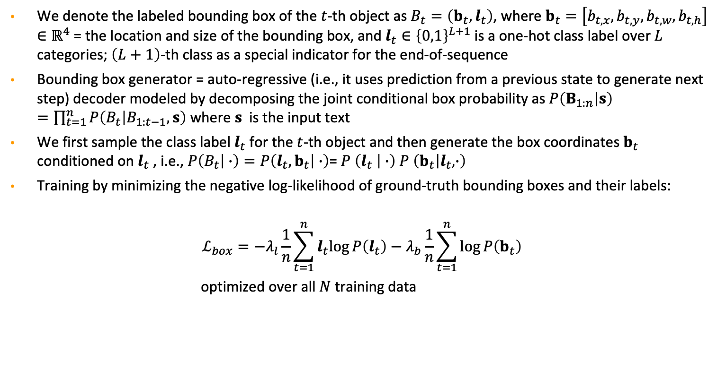
More details
Text-to-image synthesis
We denote the labeled bounding box of the $t$-th object as $B_{t}=\left(b_{t},l_{t}\right)$, where $b_{t}=\left[b_{t,x},b_{t,y},b_{t,w},b_{t,h}\right]∈ℝ^{4}$= the location and size of the bounding box, and $l_{t}∈{\left\{0,1\right\}}^{L+1}$is a one-hot class label over $L$ categories; $\left(L+1\right)$-th class as a special indicator for the end-of-sequence
Bounding box generator = auto-regressive (i.e., it uses prediction from a previous state to generate next step) decoder modeled by decomposing the joint conditional box probability as $P\left(B_{1:n} | s\right)=\prod_{t=1}^{n}{P\left(B_{t} | B_{1:t−1},s\right)}$ where $s$ is the input text
We first sample the class label $l_{t}$for the $t$-th object and then generate the box coordinates $b_{t}$ conditioned on $l_{t}$ , i.e., $P\left(B_{t} | ∙\right)=P\left(l_{t},b_{t} | ∙\right)$= $P \left(l_{t} | ∙\right)$ $P \left(b_{t} | l_{t},∙\right)$
Training by minimizing the negative log-likelihood of ground-truth bounding boxes and their labels:
$$ℒ_{box}=−λ_{l}\frac{1}{n}\sum_{t=1}^{n}{l_{t}log{P\left(l_{t}\right)−λ_{b}\frac{1}{n}\sum_{t=1}^{n}{\log{P\left(b_{t}\right)}}}}$$
optimized over all $N$ training data
Seunghoon Hong, Dingdong Yang & Jongwook Choi (2018). Inferring semantic layout for hierarchical text-to-image synthesis. In Proceedings of the Conference on Computer Vision and Pattern Recognition (CVPR).

Slide 25
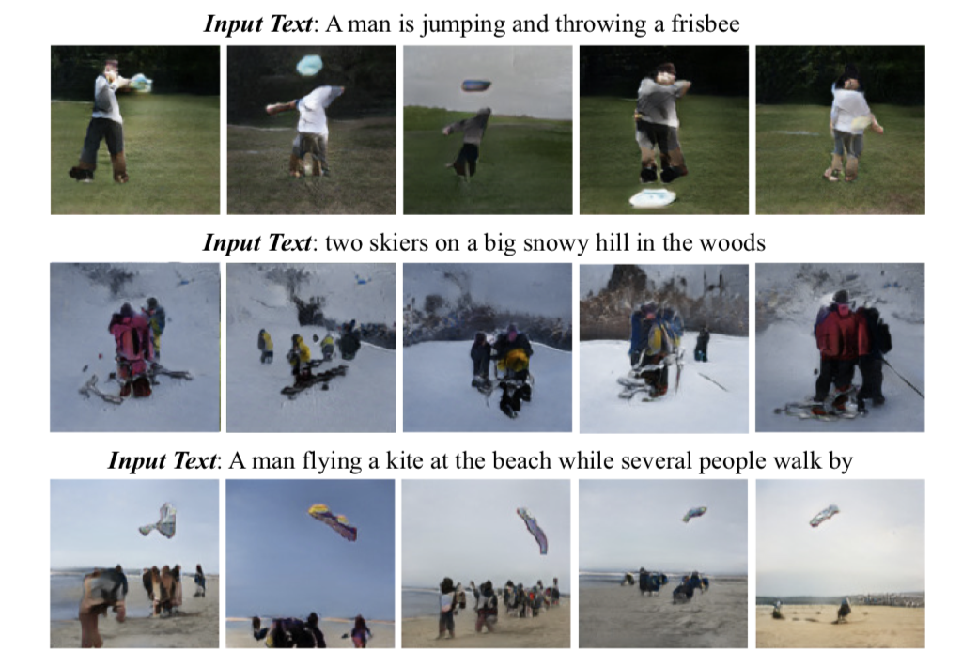
Text-to-image synthesis
Qualitative evaluation of the full image generation process
Seunghoon Hong, Dingdong Yang & Jongwook Choi (2018). Inferring semantic layout for hierarchical text-to-image synthesis. In Proceedings of the Conference on Computer Vision and Pattern Recognition (CVPR).

Slide 26
Transformer for spatial language modeling
Famous for language modeling: e.g., BERT: Bidirectional Encoder Representations from Transformers and variants
Increasingly popular for jointly modeling language and visual data: e.g., LXMERT, VilBERT, VLBERT, CLIP, etc. for better understanding of language and visual data (e.g., in visual question answering, visual dialog)
Is this architecture also suited to model spatial language?
26

Slide 27
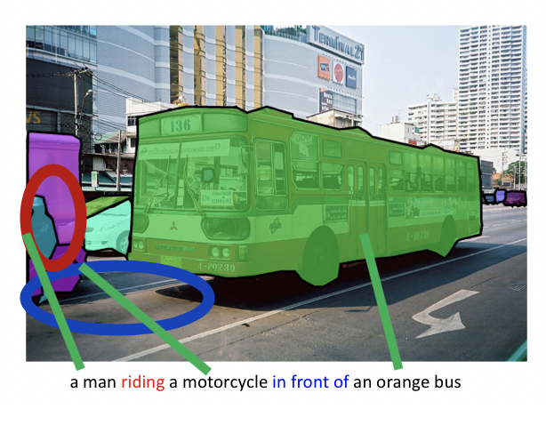
Spatial language modeling
Depending on the context, spatial language might have different meaning in terms of targeted geometry
The distance between the man and the motorcycle is usually much smaller in a city environment compared to a highway environment

Slide 28
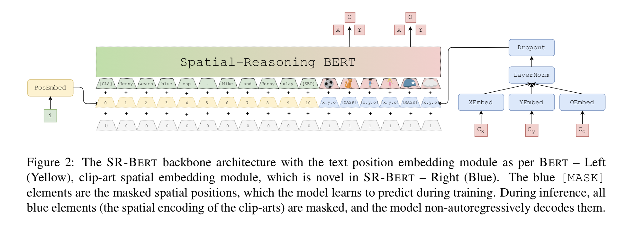
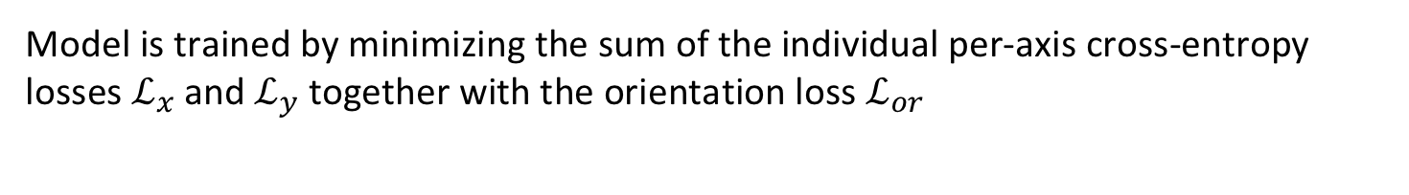
Spatial-Reasoning BERT
Model is trained by minimizing the sum of the individual per-axis cross-entropy losses $ℒ_{x}$and $ℒ_{y}$together with the orientation loss $ℒ_{or}$
Gorjan Radevski, Guillem Collell, Marie-Francine Moens & Tinne Tuytelaars (2020). Decoding language spatial relations to 2D spatial arrangements. EMNLP Findings.

Slide 29
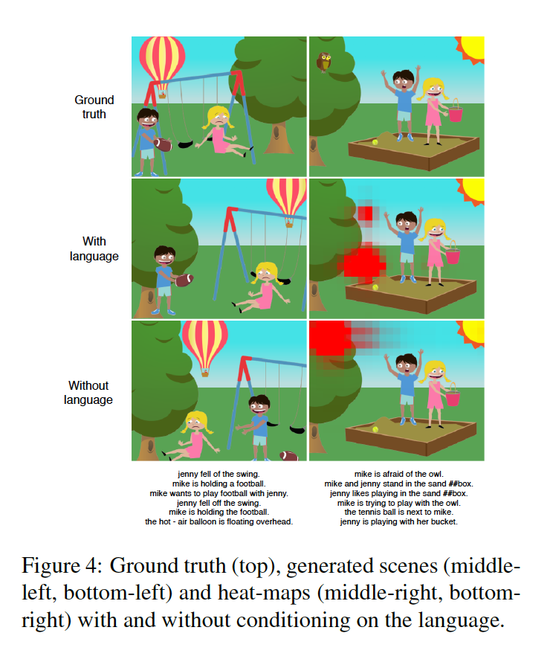
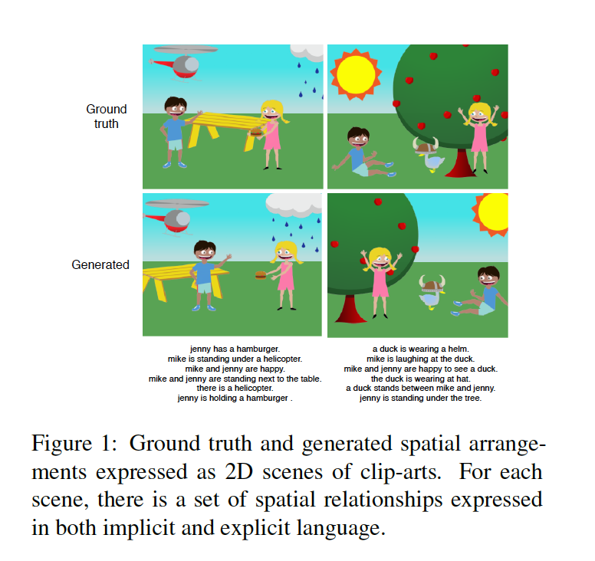
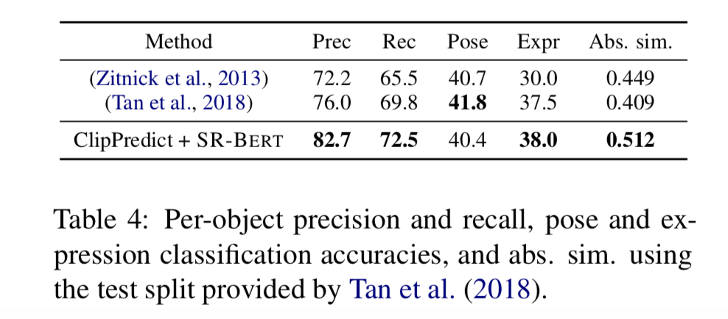
Spatial-Reasoning BERT
Quantitative and qualitative evaluation
Gorjan Radevski, Guillem Collell, Marie-Francine Moens & Tinne Tuytelaars (2020). Decoding language spatial relations to 2D spatial arrangements. EMNLP Findings.

Slide 30
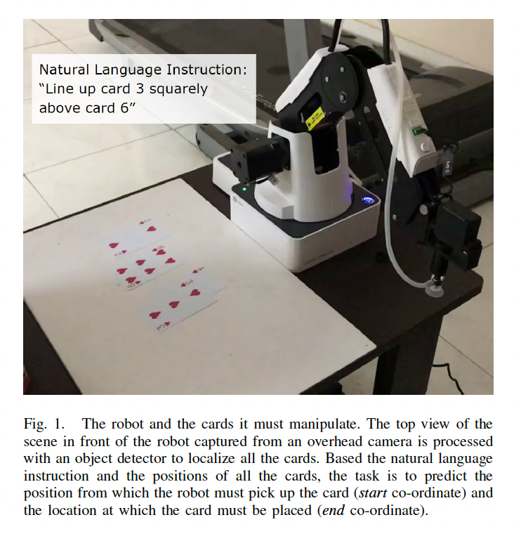
Spatial reasoning for robot manipulation
Embeddings of spatial relationships are separately created after alignments of objects in the image with the object mentioned in the text
Only evaluated in limited domain with few objects and instructions which are mainly spatial
Sagar Gubbi Venkatesh, Anirban Biswas, Raviteja Upadrashta, Vikram Srinivasan, Partha Talukdar & Bharadwaj Amrutur (2021). Spatial reasoning from natural language instructions for robot manipulation. In Proceedings of the IEEE International Conference on Robotics and Automation (ICRA 2021).
30

Slide 31
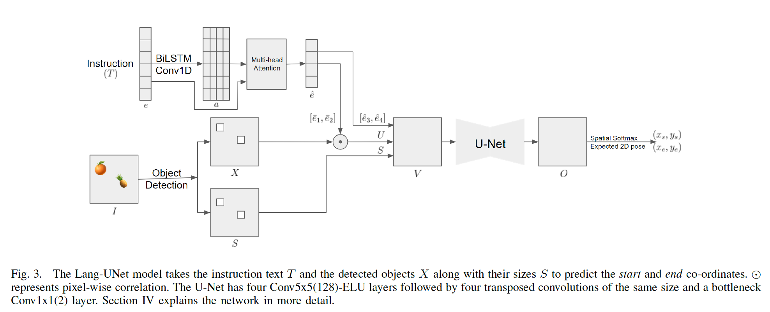
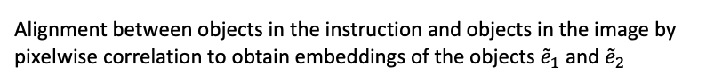
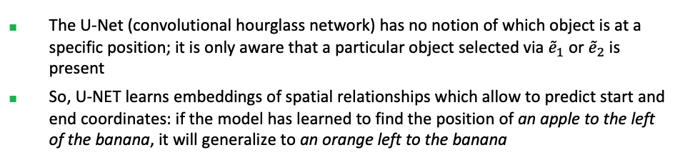

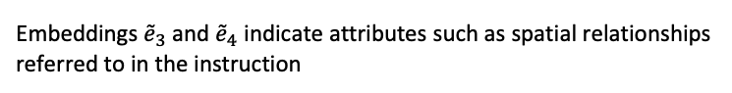
Spatial reasoning for robot manipulation
Embeddings ${\tilde{e}}_{3}$ and ${\tilde{e}}_{4}$ indicate attributes such as spatial relationships referred to in the instruction
Embeddings are concatened in $V$
Alignment between objects in the instruction and objects in the image by pixelwise correlation to obtain embeddings of the objects ${\tilde{e}}_{1}$ and ${\tilde{e}}_{2}$
Compositional generalization of the objects and their spatial relations:
The U-Net (convolutional hourglass network) has no notion of which object is at a specific position; it is only aware that a particular object selected via ${\tilde{e}}_{1}$ or ${\tilde{e}}_{2}$ is present
So, U-NET learns embeddings of spatial relationships which allow to predict start and end coordinates: if the model has learned to find the position of an apple to the left of the banana, it will generalize to an orange left to the banana
Sagar Gubbi Venkatesh, Anirban Biswas, Raviteja Upadrashta, Vikram Srinivasan, Partha Talukdar & Bharadwaj Amrutur (2021). Spatial reasoning from natural language instructions for robot manipulation. In Proceedings of the IEEE International Conference on Robotics and Automation (ICRA 2021).
31

Slide 32
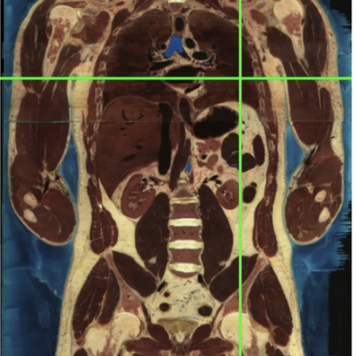
Map text to 3D
Representations of organs mentioned in medical text is projected to location in 3D atlas of the human body
Embeds medical text into a universal, small dimensional space corresponding to the human body that is easy to navigate and interpret
The volume of each organ is characterized by a set of voxels in the atlas, which capture its position, size and shape
The voxels of one organ can, in turn, be represented by a point cloud in 3D space, where each point represents the coordinates of one voxel
Task: Grounding medical text in the
human body
Dusan Grujicic, Gorjan Radevski, Tinne Tuytelaars & Matthew Blaschko (2020). Learning to ground medical text in a 3D human atlas. In Proceedings of the Conference on Computational Natural Language Learning (CoNLL). ACL.
32

Slide 33
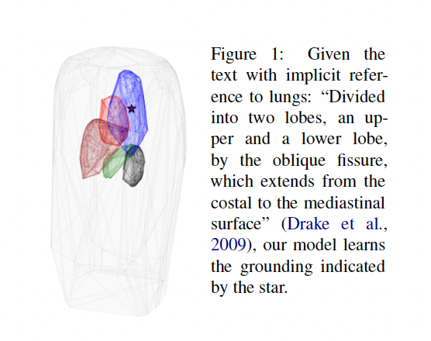
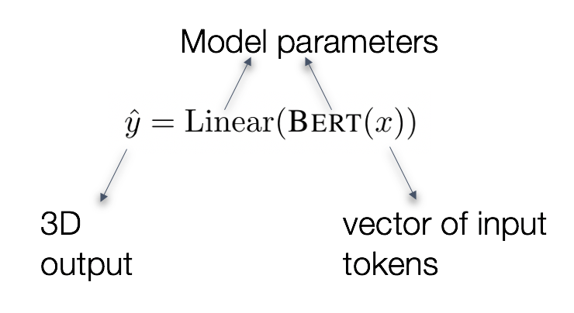
Map text to 3D
BERT backbone
Model input ー Medical text tokenized with WordPiece
Model output ー [CLS] token representation projected into 3D
Loss function: Enables reasoning about the semantic relatedness of medical text
Dusan Grujicic, Gorjan Radevski, Tinne Tuytelaars & Matthew Blaschko (2020). Learning to ground medical text in a 3D human atlas. In Proceedings of the Conference on Computational Natural Language Learning (CoNLL). ACL.
33
Notes:
We use Bert as the backbone of our model and linearly project the representation of the CLS token into a three dimensional space.

Slide 34
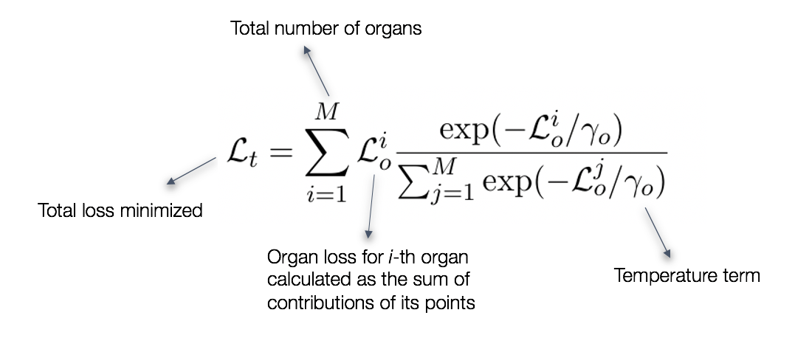
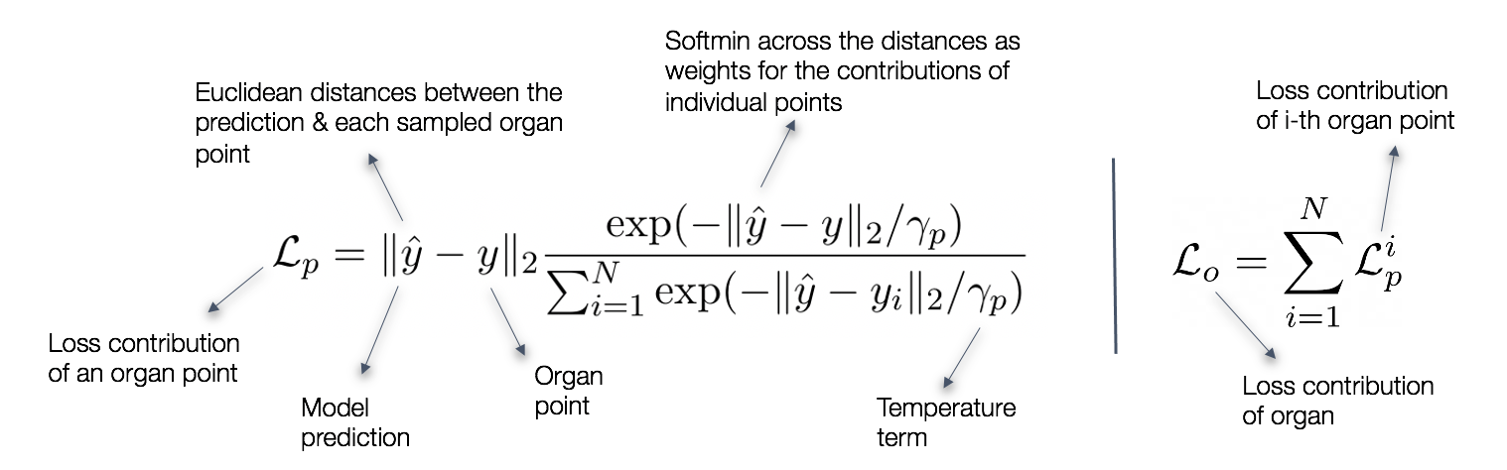
Soft Organ Distance loss
Map text to 3D
Not only grounding the medical article to the right organ but also to the appropriate location within the organ based on the other organs mentioned as context without any explicit annotations at that level of granularity
Could be refined by considering spatial language
Minimized over all
Minimized over all training instances
Dusan Grujicic, Gorjan Radevski, Tinne Tuytelaars & Matthew Blaschko (2020). Learning to ground medical text in a 3D human atlas. In Proceedings of the Conference on Computational Natural Language Learning (CoNLL). ACL.

Slide 35

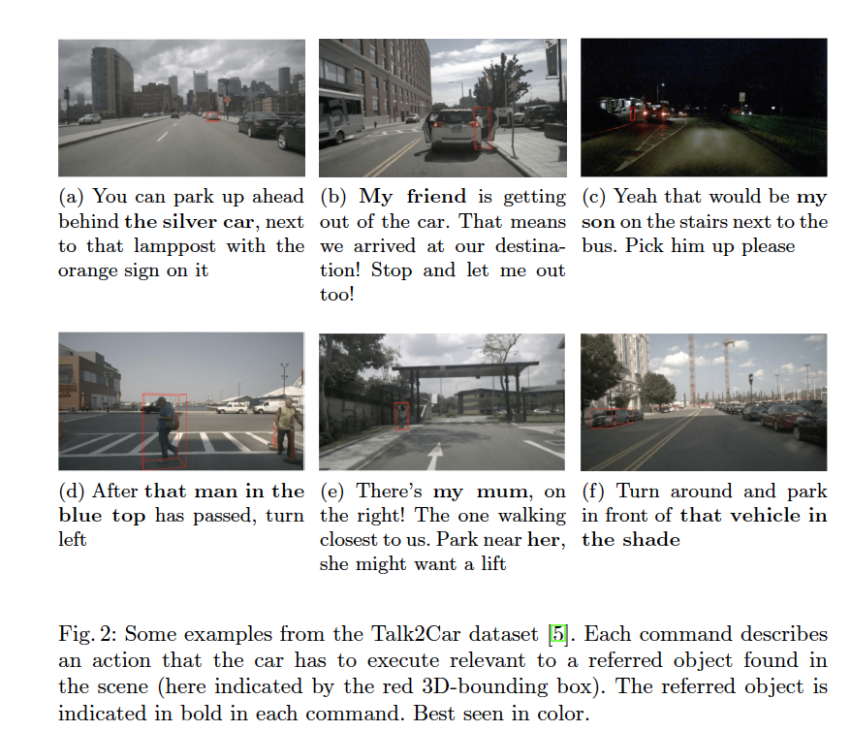
Challenge
Application: Giving a command to your self-driving car
The task of visual grounding requires locating the most relevant region or object in an image, given a natural language query.
Thierry Deruyttere, Simon Vandenhende, Dusan Grujicic, Yu Liu, Luc Van Gool, Matthew Blaschko, Tinne Tuytelaars & Marie-Francine Moens (2020). Commands 4 Autonomous Vehicles (C4AV) Workshop Summary. In Proceedings of the 16th European Conference on Computer Vision.

Slide 36
Spatial dialogue to resolve ambiguity
A component for visual uncertainty analysis
In case of uncertainty a question is generated and posed to the user to elucidate the ambiguity the robot is facing
Object causing the uncertainty generates a caption that is transformed into a question
Systems differ in how the visual uncertainty is detected

Slide 37
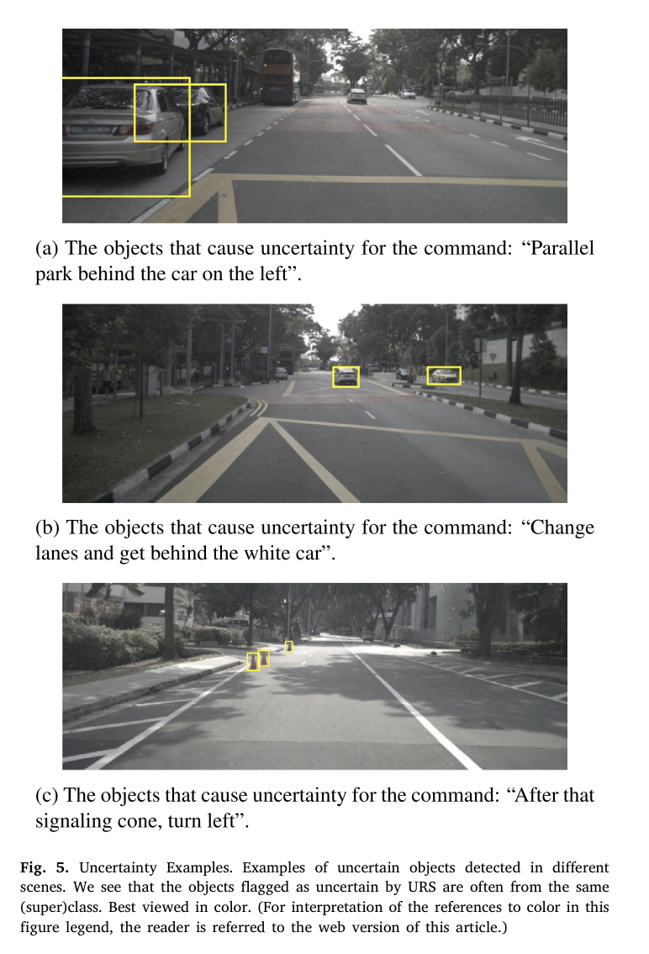
Spatial dialogue to resolve ambiguity when giving a command to a self-driving car
When detecting the referred object in the language instruction, best results for uncertainty quantification where obtained with ensemble models
Thierry Deruyttere, Victor Milewski & Marie-Francine Moens (2021). Giving commands to a self-driving car: How to deal with uncertain situations? Engineering Applications of Artificial Intelligence, 103, Art. No. 104257, 1-20.

Slide 38
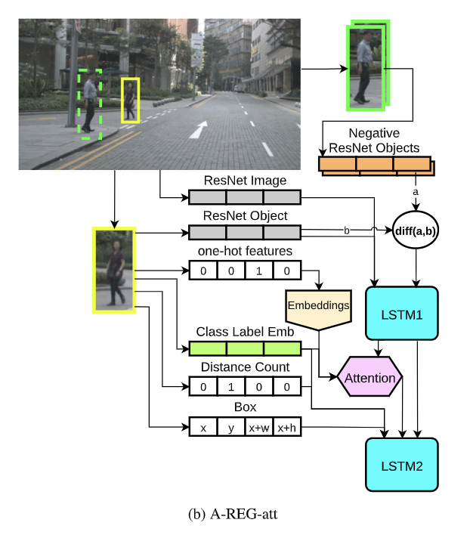
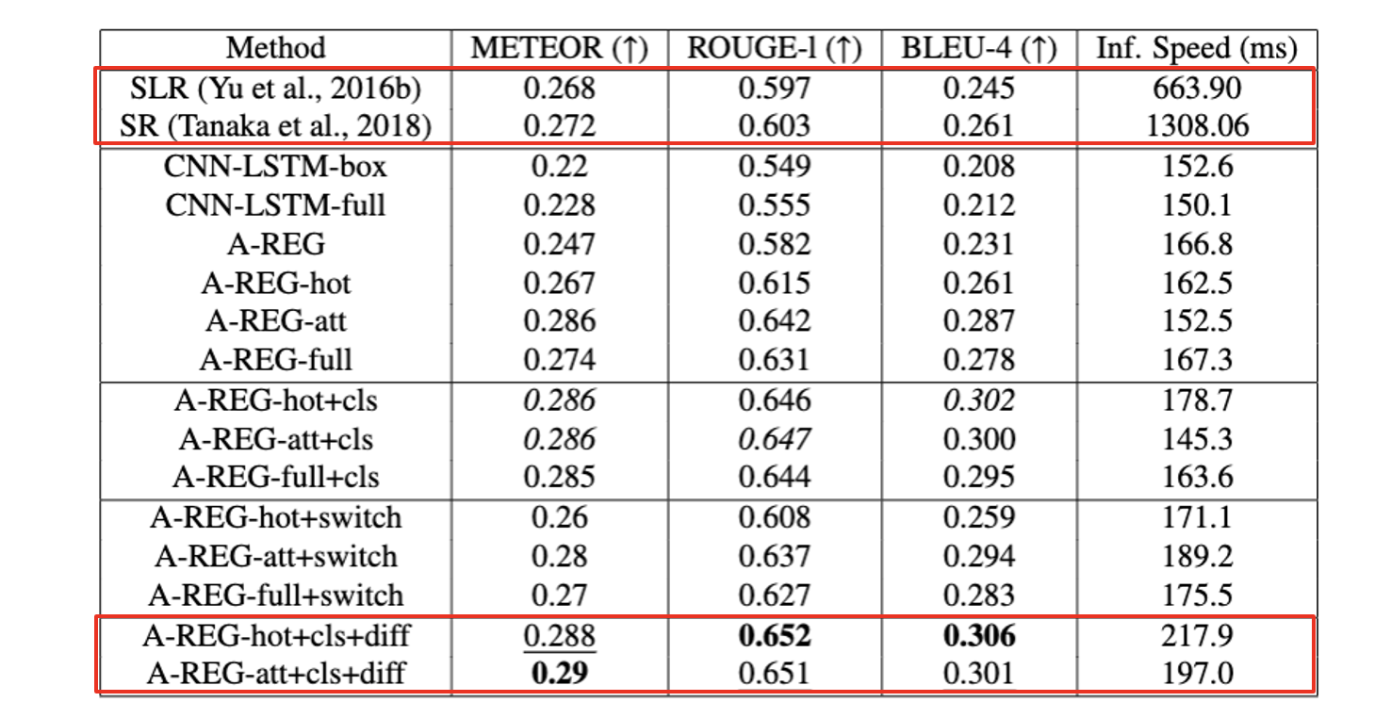
Spatial dialogue to resolve ambiguity when giving a command to a self-driving car
How can we report back the uncertainty of the self-driving to the passenger? => By generating sentences based on predicted attributes taking into account the features of other uncertain objects
Thierry Deruyttere, Victor Milewski & Marie-Francine Moens (2021). Giving commands to a self-driving car: How to deal with uncertain situations? Engineering Applications of Artificial Intelligence, 103, Art. No. 104257, 1-20.

Slide 39
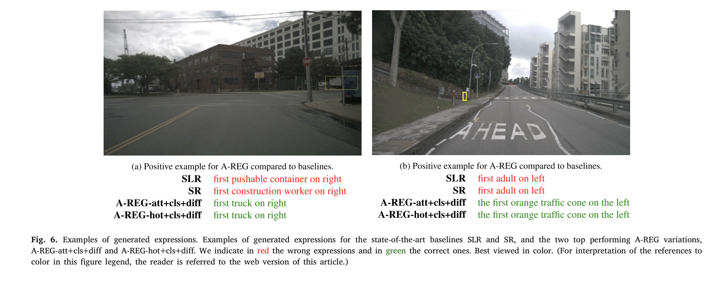
Spatial dialogue to resolve ambiguity when giving a command to a self-driving car
Based on the generated referring expression of an ambiguous object, a question is built and posed to the passenger
If passengers answer the question correctly (which we assume if mostly the case), a 9% absolute increase in terms of 𝐼𝑜𝑈.5 for referred object detection is achieved
Thierry Deruyttere, Victor Milewski & Marie-Francine Moens (2021). Giving commands to a self-driving car: How to deal with uncertain situations? Engineering Applications of Artificial Intelligence, 103, Art. No. 104257, 1-20.

Slide 40
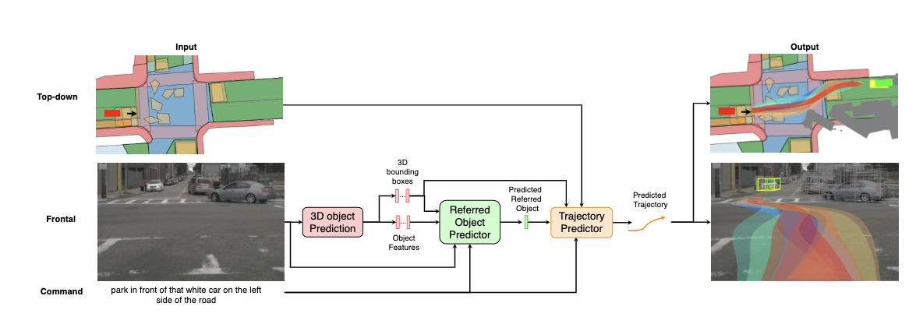
Destination and trajectory prediction
Grujicic, Dusan, Deruyttere, Thierry, Moens, Marie-Francine & Blaschko, Matthew B. (2022). Predicting Physical World Destinations for Commands Given to Self-Driving Cars. In Proceedings of the Thirty-Sixth AAAI Conference on Artificial Intelligence (AAAI 2022) (pp. 715-725). AAAI.
40

Slide 41
Reasoning in physical space
The above approaches allow reasoning in the physical space (2D or 3D): is useful in processing human-machine communications: e.g.,
Communications with robots and autonomous vehicles: inference of additional spatial information
Still large potential for learning from video data coupled with language
When to reason in the language space (use of spatial ontology) and when in the physical space is an interesting research question
Both methods are transparent for humans and contribute to the explainability of the models

